Slide 1
Series of AeoLiS animations

Slide 2
Explain observations
Over-estimation of sediment transport
Varying fetch effects
Tide dependency

Slide 4
1. Constant sediment supply varying wind
New animation is available, but I got lazy and want to move on.

Slide 5
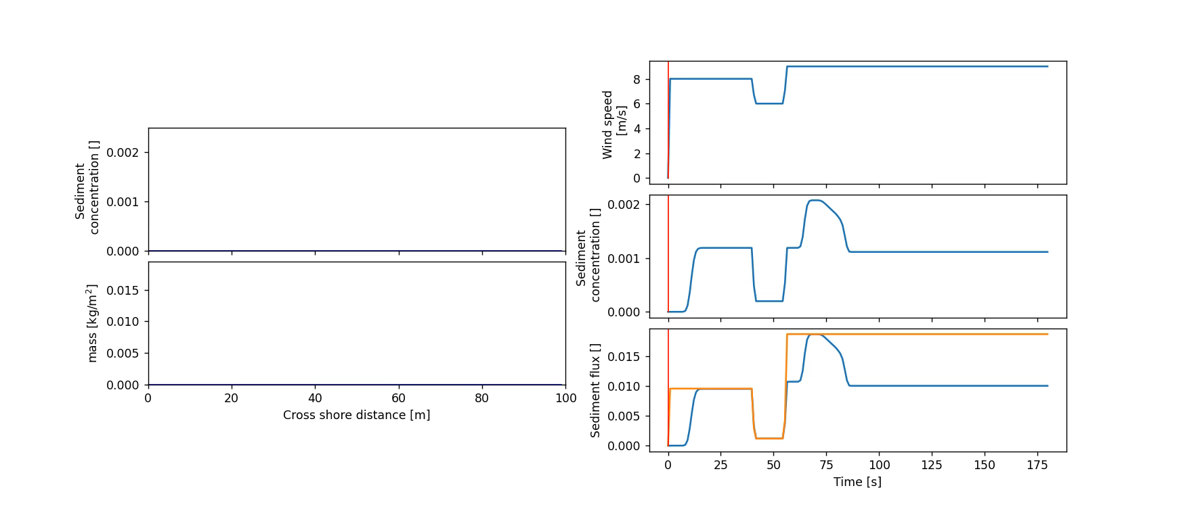

Slide 8
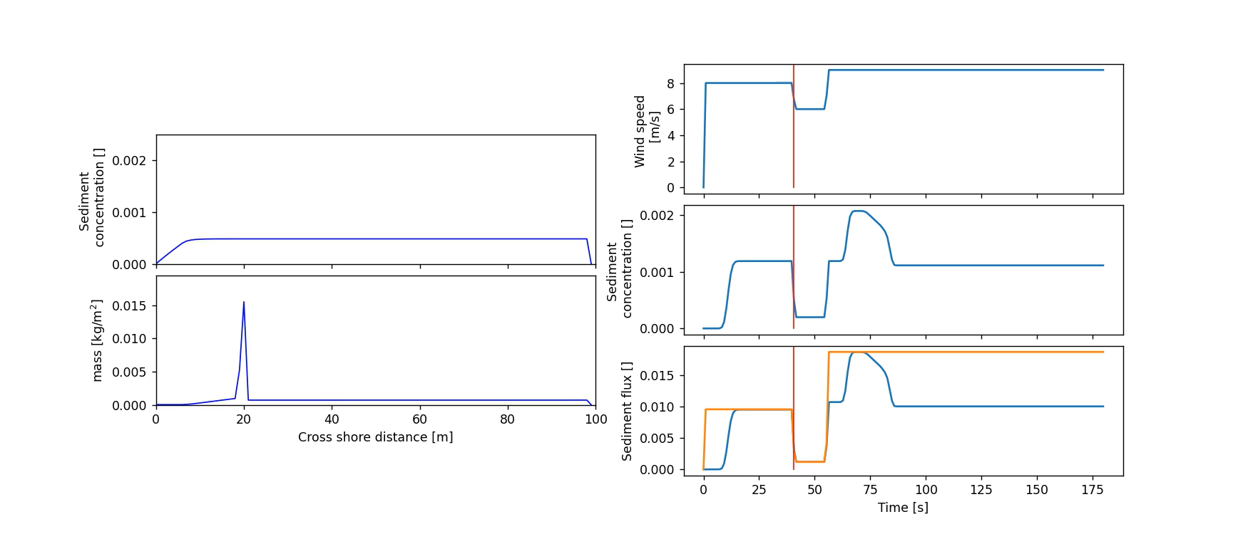

Slide 9
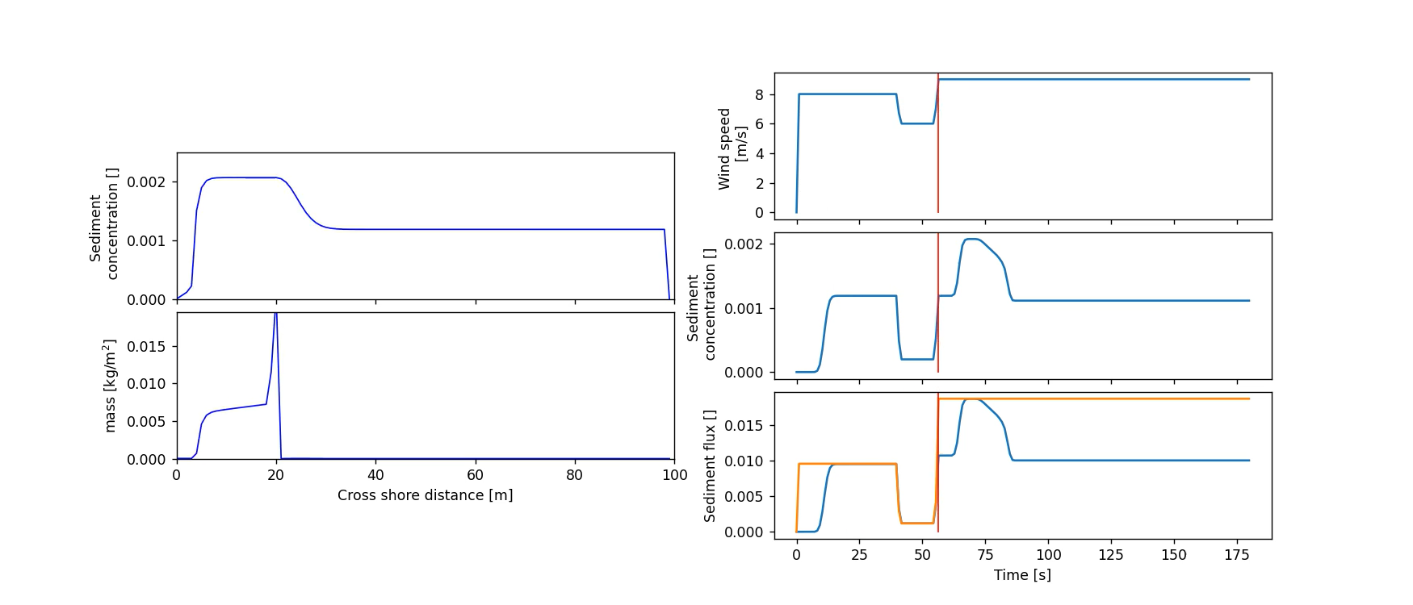

Slide 10
Tide dependency

Slide 13
Varying wind direction

Slide 15
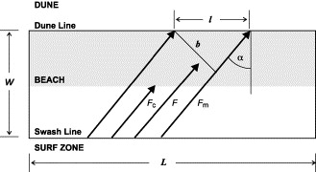
Comparable to the work of Bauer and Davidson Arnott.

Slide 20
